Slide 1
Announcements
Congratulations on turning in your Closed Memo!
I will post a link in Microsoft Bookings for you to sign-up for a conference time for discuss your Closed Memo Discussion Section. Your conference will be 5% of your total grade this semester. They will be held September 23 – October 2.
We will be focusing on research for the next 4 weeks. Bring your laptop to every class! Your in-class research assessment is on October 8. It will count for 15% of your total grade this semester.

Slide 2
Legal Writing Center Workshops – Required to Attend One of These
1. Grammar and Punctuation Skills Workshop
· Team: Erin Eldridge, Sophia Kostiuk, Casey McKee, and Kevin “Mark” Richards
· Date: Wednesday, September 23, from 12:00 p.m. to 12:50 p.m.
· Location: Room 220
2. Bluebook Citation Skills Workshop
· Team: Maria Magana, Emma Schmitt, and Sarah Williams
· Date: Wednesday, October 28, from 12:00 p.m. to 12:50 p.m.
· Location: Room 220

Slide 3
How To Prepare For Your Closed Memo Discussion Section Conference
Present your discussion section by addressing the following (include principle we included in class):
  Discuss the organization (CREAC) of your discussion section.
  Describe how you constructed your rule statement.
  Explain how you chose your case illustrations and why you positioned them where you did. (Why did you choose the case(s) that you did to support your conclusion? How did you distinguish case(s) that did not support your conclusion?)
  Discuss your fact comparisons in your application sections
    How did you choose which facts to compare?
    Did you directly compare Jalen’s facts with the facts from the case law?
    In the cases that supported your conclusion, how did you choose to address facts in that differed from Jalen’s?
Which part of the assignment came easiest to you and where did you struggle?
Be sure to discuss how you used the principles we have discussed in class so far. I am not looking for perfection, but thoughtful preparation. The act of writing the discussion section should get you most of the way there, but make sure to come ready to thoroughly discuss.

Slide 4
Today
Hierarchy of Authority and Court Systems
Four Part Legal Research Process
Introduction to Legal Research Databases

Slide 5
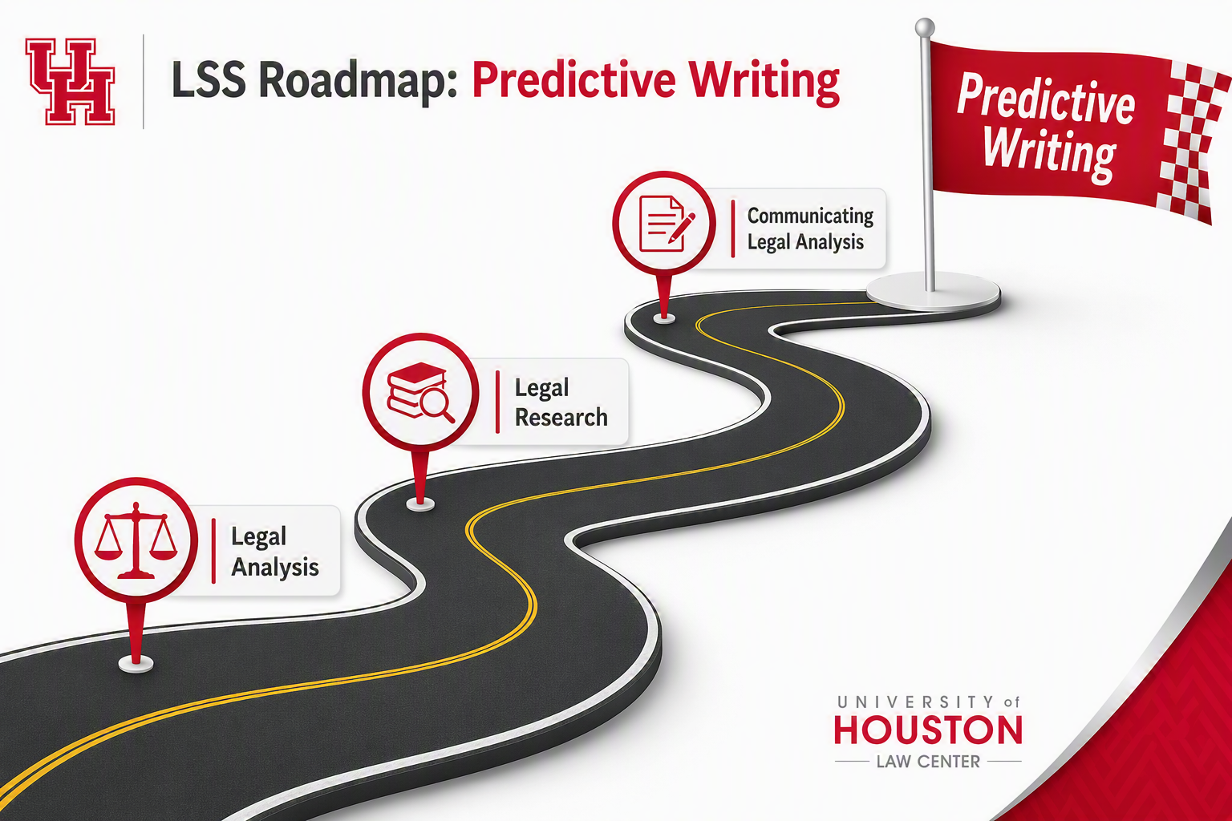

Slide 6
Overview Question
Why do you think we started with legal analysis (CREAC) before legal research, which comes before legal analysis in practice?

Slide 7
Law vs. Guides for Finding Law
Primary Authority –any law emanating from a branch of government the (the“Law”).
  Constitution
  Statutes
  Regulations
  Case Law
Secondary Authority – materials that describes the law (or a guide for finding the “Law”)
  e.g. legal encyclopedia, treastises, dictionary, law review articles.

Slide 8
Types of Law
  ENACTED LAW
  Constitutional provisions
  Statutes
  Regulations
  Local Ordinances
CASE LAW
  Decisions Interpreting Enacted Law
  Common Law Decisions

Slide 9






What are the four principles for determining the weight of authority?
Notes:
Page 20 of Becoming a Legal Writer.

Slide 10
Determine the Hierarchy of Authority
Constitutions
Statutes/Regulations
Case Law
*State and Federal Court

Slide 11
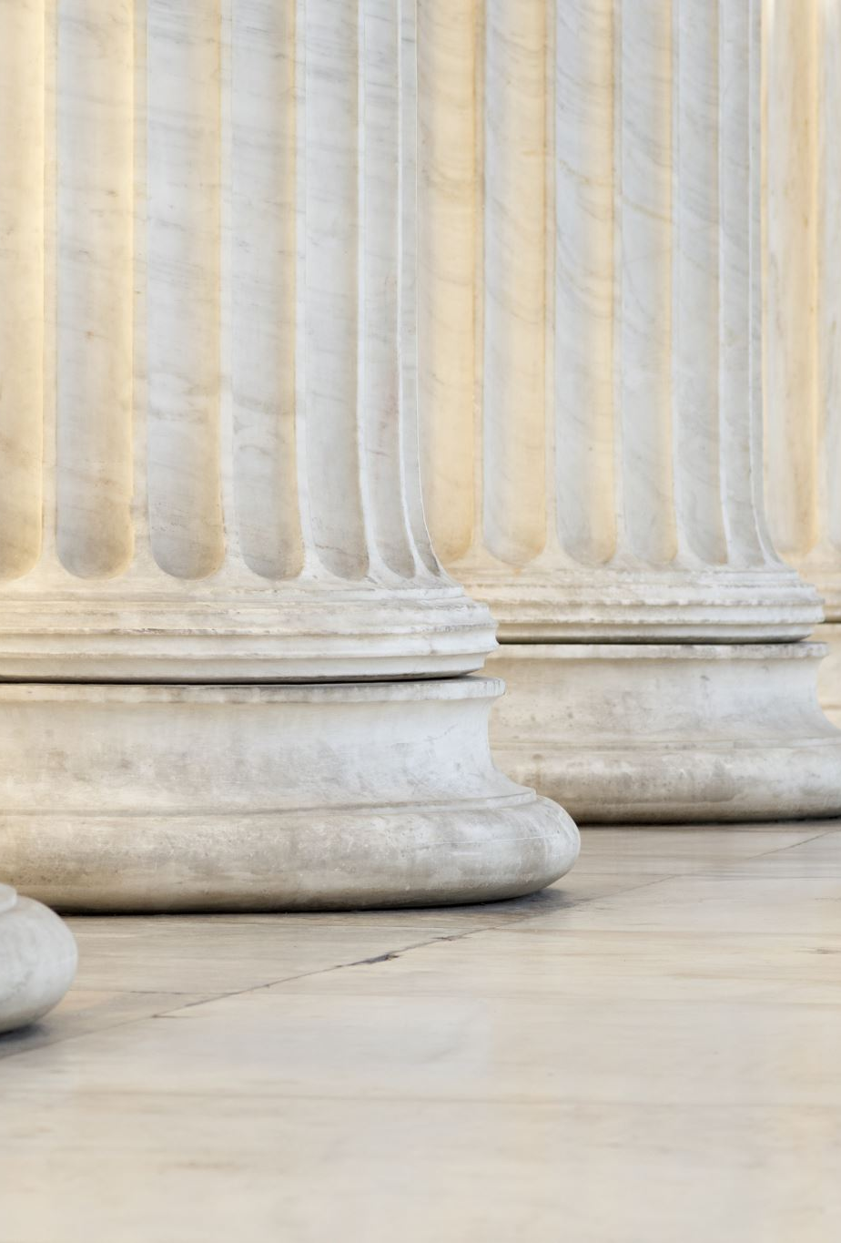
Test our Understanding
Which court system is the final arbiter of a state law?

Slide 12
Mandatory vs. Persuasive Authority
DEFINITIONS
Mandatory Authority – Law which is binding on the court deciding the case.
Persuasive Authority – Non-binding law which can influence the court deciding the case.

Slide 13
Mandatory vs. Persuasive Authority
RULES
Mandatory authority includes enacted laws in the jurisdiction.
Mandatory authority includes opinions of higher courts to which your case could be appealed.
If your case is pending before an appellate court, decisions of that same appellate court are also mandatory authority because of stare decisis.
  Must be regarding the same legal issue – same law and similar facts

Slide 14
Determine the Hierarchy of Authority for Cases
Federal Court:
U.S. Supreme Court and Circuit Court decisions from your circuit are mandatory
Out-of-circuit appellate court decisions and district court decisions are persuasive
State Court:
Supreme Court and Appellate Court decisions of your state are mandatory
Trial court decisions are persuasive, but not binding, and generally are not published
Out-of-state decisions are only persuasive
Supreme Court
Appellate Courts
Trial Courts

Slide 15
LEVELS OF COURTS
FEDERAL
MOST STATES
Supreme Court
Intermediate Appellate Court
Trial Court
United States
Supreme Court
<- - - - -
Supreme Court
United States Circuit
Courts of Appeals
(13 Circuits)
Court of Appeal
United States
District Courts
(4 in Texas)
Superior Court
Notes:
Go over hypos here- read them

Slide 16
ANALYSIS
Where is your case – in federal court or a specific state court (which state)?
Do any enacted laws from the jurisdiction apply?
Is there an on-point opinion from a higher court to which your case could be appealed?
Is there an on-point opinion from the same appellate court in which your case is pending?

Slide 17
BLW Exercises Chapter 2 – 2.1, 2.3, 2.5 https://www.fjc.gov/history/courts/u.s.-district-courts-districts-texas and https://txcourts.gov/ for Exercise 2.3

Slide 18
The Four-Step Legal Research Process
Problem Analysis
Issue Analysis
Statutory Analysis
Case Analysis

Slide 19
Homework for Thursday
Sign-Up for Conferences – Look for an e-mail for me later today with instructions
Complete Legal Research Modules 2.4-2.7 by 5 p.m. Tuesday, 9/22
Complete Legal Research Modules 3.1-3.3 by CLASS TIME Thursday, 9/24
Read Bennett-Glass Problem posted in the Week 5 Module in Canvas as we will do research exercises in class
For Sunday (9/27)
  Complete selected ICW 6 and 7 by Sunday 9/27 at 5:00 p.m. (selected problems and instructions are posted in the Week 5 Canvas Module)

